Slide 1
PROJECT TIME MANAGEMENT SYSTEM
MINI PROJECT
Department of MCA, MES College of Engineering Kuttippuram.
27th OCTOBER 2023
PREPARED BY
AYISHA FAHMA K (MES22MCA-2013)

Slide 2


Slide 3
CONTENTS
Introduction
Modules
Product Backlog
Project Plan
Sprint
Data Flow Diagram
Developing Environment

Slide 4
INTRODUCTION
Project Time Management System is a web-based application that provides an online platform for a company to manage their project/task progress. The system has 2 types of users, Admin or Project Manager and the Regular Employee.
Project Manager manages the project details like assigning new project at first along with some important details and references to do the job by allocating employee and oversee the progress under his or her category.
Employee can submit their work productivity in each task of the project that they are assigned which makes the system requires the employee to submit their start and end time range of their work on a certain task and this data will be calculated in the report as project member’s work duration.
As the employees regularly updating the system about the progress they have done, the project manager will read or scan their activities so the project manager can check or decide if the certain task is done and need to update the task status in the system.

Slide 5
MODULES
ADMIN
LOGIN
PROJECT MANAGEMENT
EMPLOYEE MANAGEMENT
TASK MANAGEMENT
REVIEW TASK PROGRESS
USER(EMPLOYEE)
LOGIN
VIEW LIST OF TASK
VIEW ASSIGNED TASK
UPDATE TASK PROGRESS

Slide 6
PRODUCT BACKLOG
ID | PRIORITY | SIZE (Hours) | SPRINT | STATUS | NAME
1 | Medium | 4 | 1 | Partially Completed | Form Design
2 | High | 4 | 2 | Planned | Table Design
3 | High | 23 |  | Planned | Coding
4 | Medium | 4 | 3 | Planned | Testing Data
5 | High | 6 |  | Planned | Output Generation

Slide 7
PROJECT PLAN
ID | TASK NAME | START DATE | END DATE | PROJECT HOURS | STATUS
1 | Sprint 1 | 15/09/2023 | 12/10/2023 | 13 | Planned
2 | Sprint 2 | 13/10/2023 | 03/11/2023 | 14 | Planned
3 | Sprint 3 | 08/11/2023 | 30/11/2023 | 14 | Planned

Slide 8
SPRINT PLAN
SPRINT 1
Backlog Item | Status and Completion date | Original Estimate in hours | Day 1 15/9 | Day 2 20/9 | Day 3 21/9 | Day 4 28/9 | Day 5 29/9 | Day 6 04/ 10 | Day 7 05/ 10 | Day 8 06/ 10 | Day 9 11/ 10 | Day 10 12/ 10
Form design | 15/09/ 2023 | 2 | 2 | 0 | 0 | 0 | 0 | 0 | 0 | 0 | 0 | 0
Table Design | 28/09/ 2023 | 3 | 0 | 1 | 1 | 1 | 0 | 0 | 0 | 0 | 0 | 0
Coding | 06/10/ 2023 | 6 | 0 | 0 | 0 | 0 | 2 | 1 | 1 | 2 | 0 | 0
Testing & Validation | 12/10/ 2023 | 2 | 0 | 0 | 0 | 0 | 0 | 0 | 0 | 0 | 1 | 1
Total |  | 13 | 2 | 1 | 1 | 1 | 2 | 1 | 1 | 2 | 1 | 1

Slide 9
SPRINT 2
Backlog Item | Status and Completion date | Original Estimate in hours | Day 1 13/ 10 | Day 2 18/ 10 | Day 3 19/ 10 | Day 4 20/ 10 | Day 5 25/ 10 | Day 6 26/ 10 | Day 7 27/ 10 | Day 8 01/ 11 | Day 9 02/ 11 | Day 10 03/ 11
Form design | 13/10/ 2023 | 2 | 2 | 0 | 0 | 0 | 0 | 0 | 0 | 0 | 0 | 0
Table Design | 18/10/ 2023 | 1 | 0 | 1 | 0 | 0 | 0 | 0 | 0 | 0 | 0 | 0
Coding | 01/11/ 2023 | 8 | 0 | 0 | 1 | 2 | 1 | 1 | 2 | 1 | 0 | 0
Testing & Validation | 03/11/ 2023 | 3 | 0 | 0 | 0 | 0 | 0 | 0 | 0 | 0 | 1 | 2
Total |  | 14 | 2 | 1 | 1 | 2 | 1 | 1 | 2 | 1 | 1 | 2

Slide 10
SPRINT 3
Backlog Item | Status and Completion date | Original Estimate in hours | Day 1 08/ 11 | Day 2 09/ 11 | Day 3 10/ 11 | Day 4 15/ 11 | Day 5 16/ 11 | Day 6 17/ 11 | Day 7 22/ 11 | Day 8 23/ 11 | Day 9 24/ 11 | Day 10 29/ 11 | Day 11 30/ 11
coding | 01/11/2023 | 9 | 1 | 1 | 2 | 1 | 1 | 2 | 1 | 0 | 0 | 0 | 0
Testing& Validation | 03/11/2023 | 5 | 0 | 0 | 0 | 0 | 0 | 0 | 0 | 1 | 2 | 1 | 1
Total |  | 14 | 1 | 1 | 2 | 1 | 1 | 2 | 1 | 1 | 2 | 1 | 1

Slide 11
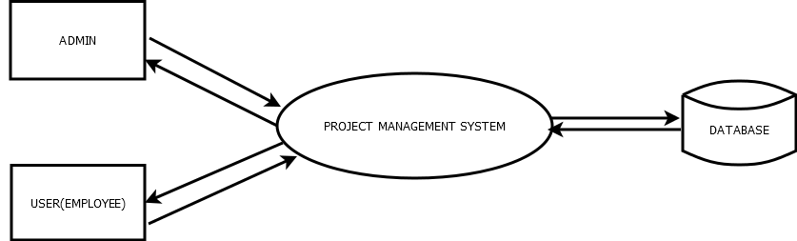
DFD
LEVEL 0

Slide 12
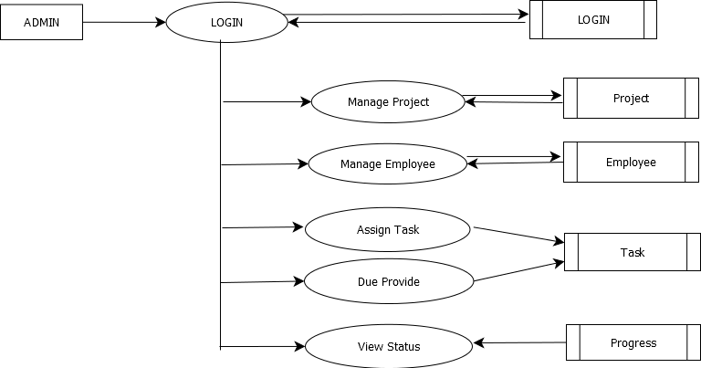
LEVEL 1 ADMIN

Slide 13
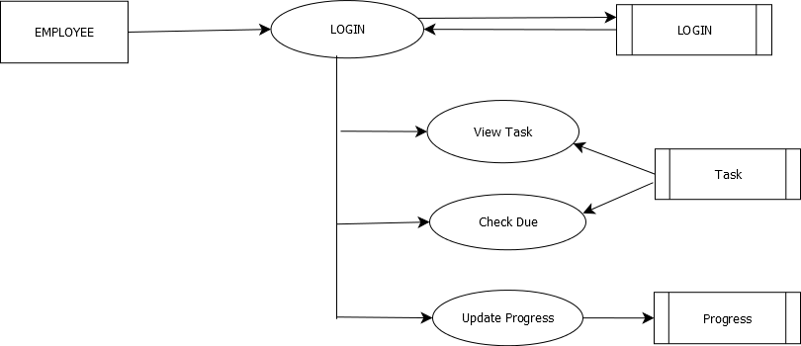
LEVEL 1 EMPLOYEE

Slide 14

SOFTWARE SPECIFICATION
Operating System
Frond End
Framework
Backend
Web Server
IDE
Browser
: Windows 7 or above
: HTML,CSS
:Bootstrap
:PHP , MySQL
:XAMPP/WAMP
: Visual Studio Code / NetBeans
:Chrome / FireFox

